Slide 1
Driving Direction Sensing for Autonomous Driving Vehicles (ADV)
Design philosophy: Imitating human drivers (no need for dynamic model of the vehicle)
Control action: Lateral and longitudinal control
Positioning system: Lidar, Vision, Ultrasound, accelerometer (speed and acceleration), magnetometer (direction) plus GPS etc.
Harry Li, Ph.D. April 2015

Slide 2
ADV Background (1/2)
- Prof. Tsugawa, Proportion control, Computer Vision, and GPS, Japan 1972.
- ARGO project developed at Parma University, Italy, Prof. Broggi for public highway driving, Proportional Control, Vision, GPS. 1999.
- Chaib et al. Lateral control, French Institut National De Recherche sur les Transports et Leur Securite (INRETS), H∞, adaptive, PID, fuzzy controllers, 2004.
- Carnegie Mellon University NavLab, “Ralph”, Vision, Neural-network-based lateral position handler, 1995.
Harry Li, Ph.D. April 2015

Slide 3
ADV Background (2/2)
- Lateral controllers, Advanced Transit and Highways (PATH) program, 2000.
- Hessburg, lateral-vehicle-guidance system based on fuzzy control on Toyota Celica vehicle, 1994.
- Sugeno's fuzzy technique handling nonlinear control to maneuver a model car using oral instructions, 1985.
- Autonomous-steering, humanlike tracking by Sotelo 2003 etc.
Harry Li, Ph.D. April 2015

Slide 4
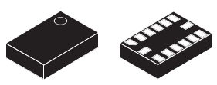
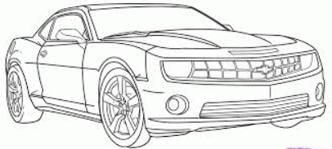
Sensors for Driving Direction and Turning Angle
eCompass module:
3D accelerometer and 3D magnetometer
Caution: Steering sensor input is not necessarily the real angle of the vehicle, “skipping” may occur
Use LSM303 or equivalent to sense the direction of the vehicle
Actual trajectory
Angular error
Reference trajectory
Angular error
Lateral error
The LSM303DLHC includes an I 2 C serial bus
interface that supports standard and fast mode
100 kHz and 400 kHz. The system can be
configured to generate interrupt signals by inertial
wake-up/free-fall events as well as by the position
of the device itself.
Reference trajectory
Use
Actual trajectory
Harry Li, Ph.D. April 2015

Slide 5
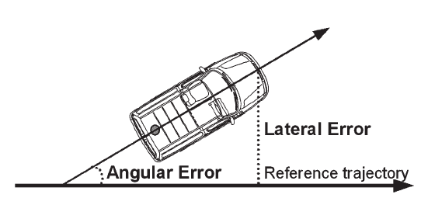
Angular Error to Lateral Error
Action:
Write a C program to compute lateral error
void Ang2LateralError(float speed; float angularError; float lateralError);
Simulate Lateral Error from Angular Error based on Vehicle model
Vehicle Model:
1. The Physical Dimension of the Vehicle: Length 1200 mm, Width 500 mm. Use #define Length 1200 etc.
2. Speed input: [Speed_Max, Speed_Min], #define Speed_Max 2000000 //in mm, 20 KM per hour.
Action:
(1) Write C-code to with two inputs, one speed, and one angular to find lateral error .
Error_Lat = Speed * Sin(Error_Ang) … (10.1)
LateralError_max
Per each speed
LateralError_min
AngularError_min (0)
AngularError_max (60 Deg)
Harry Li, Ph.D. April 2015

Slide 6
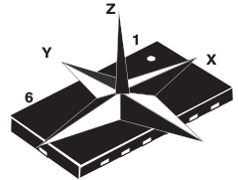
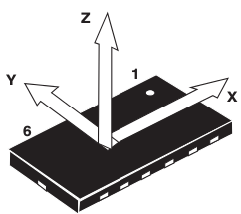


3D Accelerometer and
3D Magnetomete LMS303
3D magnetometer
3D accelerometer
Table 9
I2C Interface
(1) The transaction started through a START (ST) signal, defined as a high-to-low on the data line while the SCL line is held high.
(2) After ST, the next byte contains the slave address (the first 7 bit), bit 8 for if the master is receiving or transmitting data.
(3) When an address sent, each device compares the first seven bits after ST. If they match, the device is addressed.
Reference: Table 9, pp 19, from LSM303 datasheet
Harry Li, Ph.D. April 2015

Slide 7
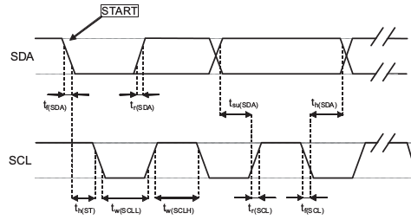
I2C Handshaking LMS303
Table 11. Transfer when master is writing one byte to slave, pp 20, datasheet
Master
ST
Slave
SAD+W
SAK
SUB
SAK
Figure 3. I 2 C slave timing diagram, pp 13 from datasheet
Harry Li, Ph.D. April 2015

Slide 8
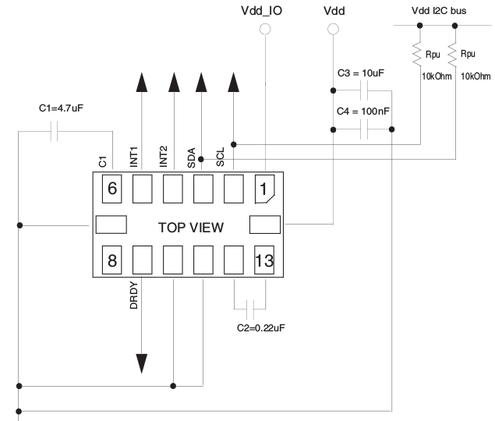
3D Accelerometer/Magnetomete Wire Diagram
pp. 17, figure 4 from datasheet
Pull up resistors
GND
Harry Li, Ph.D. April 2015

Slide 9
Sensing for Close Loop Control
PID Control
Reference Input
E(S)
C(S)
+
G(S)
Multi-dimensional vector feed back from vehicle sensors for possible control actions, including driving directions
R(S)
Controlled
output
H(S)
K_p
E(S)
R(S)
K_i
C(S)
+
G(S)
d
K_d
dx
H'(S)
H(S)
Harry Li, Ph.D. April 2015

Slide 10
PID Control for ADV
- PID control design, P: proportional, I: integral, D: derivative control. Use central difference to find derivative.
- void Derivative
( float x[Length], float cDerivative[Length]);
void Integral( float x_[Length], Sum_x[Length]);
void PIDControl( float x_[Length], cntlAction);
void cntlActionPwm ( float cntlAction, PwmAction);
- Intelligent controller implementation by fuzzy control (1) incorporates human knowledge, (2) rule based handling nonlinearities of the vehicle’s dynamics.
Harry Li, Ph.D. April 2015

Slide 11
Control Action to PWM
void Derivative
( float x[Length], float cDerivative[Length]);
void Integral( float x_[Length], Sum_x[Length]);
void PIDControl( float x_[Length], SumFromError[Length2]);
void cntlActionPwm ( float SumFromError, PwmAction);
SumFromError = K_P*Error + K_d*cDerivative[i]+K_i*Sum_x[i]
f_PWM_max
(100 KHz)
1500 (PWM neutral point)
Write C-code to map control action to PWM output
void cntlActionPwm
( float SumFromError, PwmAction);
SumFromError_max
f_PWM_min (0 Hz)
SumFromError_min
(negative)
0
Harry Li, Ph.D. April 2015
Harry Li, Ph.D. April 2015

Slide 12
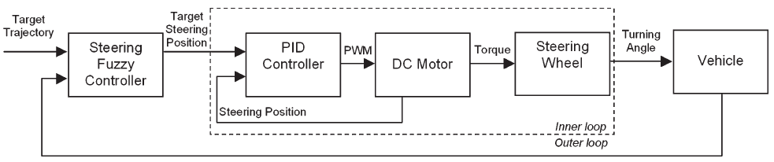
ADV Formulation
GPS
Positioning
Controller
Steering
Actuation
Vehicle
Wheel Dir
Vision/Graphical Guide
Vehicle
Speed
PWM output ---> Steering Motor ---> Angular Position ---> Displacement of the Vehicle (error)
J.E. Naranjo et al 2005
Harry Li, Ph.D. April 2015

Slide 13
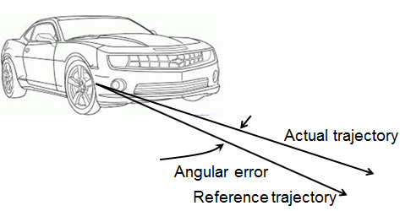
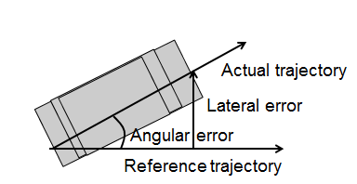
Controller Implementation
B
C
D
E
A
J.E. Naranjo et al 2005
1. Target Trajectory is set by your ADC input (change POT to simulate the change of trajectory)
2. Turning angle is set by simulation of C and D
3. Vehicle lateral error is simulation by your lateral error program
Target Trajectory e.g. reference trajectory, set by two ADC outputs as a vector for (x_i,y_i) for i=0,1,2,...,N-1
Harry Li, Ph.D. April 2015

Slide 14
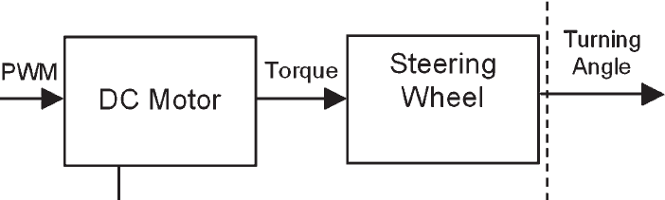
PWM to Turning Angle
Turning angle is set by simulation of C and D
2.
[Angle_min, Angle_max]
1.
[f_PWM_min, f_PWM_max]
Action:
(1) Write C-code to allow f_PWM change frequency, just use PWM example program and the PWM driver program.
Angle_max
(15 degree)
(2) Write C-code to map PWM output to the angle.
Angle_min
(0 degree)
f_PWM_min (0 Hz)
f_PWM_max
(100 KHz)
Harry Li, Ph.D. April 2015

Slide 15
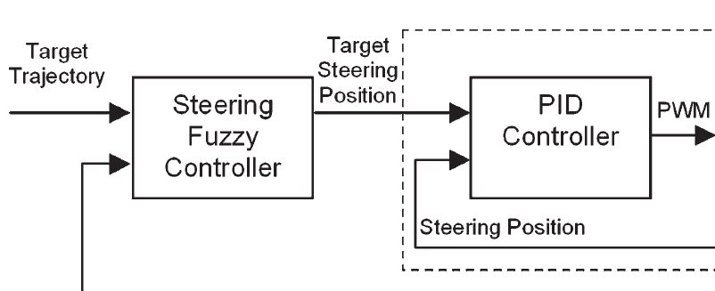
PID Controller Design
Lateral Error
from Simulation program,
void Ang2LateralError();
Action:
Write a C program to simulate, e.g., read from ADC input as the target trajectory:
void TargetTrajectory(float GPositnX, GPositnY; float CVPositnX, CVPositnY; float TPositnX, TPositnY);
Harry Li, Ph.D. April 2015

